Slide 1
Unit 2
Richard Palmer

Slide 2
## ## Attaching package: 'dplyr'
## The following objects are masked from 'package:stats': ## ## filter, lag
## The following objects are masked from 'package:base': ## ## intersect, setdiff, setequal, union

Slide 3
Question 1
Show the number of players per position

Slide 4
Question 2
Compare the distribution of weight of centers with that of the weight of forwards
## Warning: Removed 3 rows containing non-finite values (stat_bin).

Slide 5
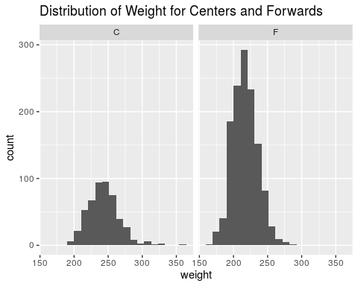

Slide 6
Question 3
Compare the distribution of the height of centers with that of the height of forwards

Slide 7
Question 4
Investigate distribution of height across all positions

Slide 8
Question 5
Investigate how a players height is related to his weight
## Warning: Removed 6 rows containing missing values (geom_point).

Slide 9
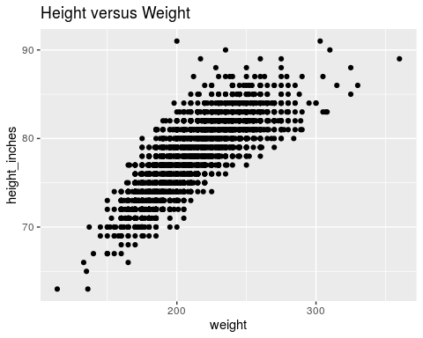

Slide 10
Question 6
Is there any difference in height/weight relationship among positions?
## Warning: Removed 6 rows containing missing values (geom_point).

Slide 11
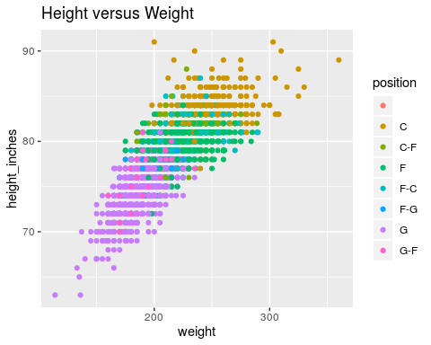

Slide 12
Question 7
Is there any evidence that height has changed over the years?
## Warning: Removed 1 rows containing missing values (geom_point).

Slide 13
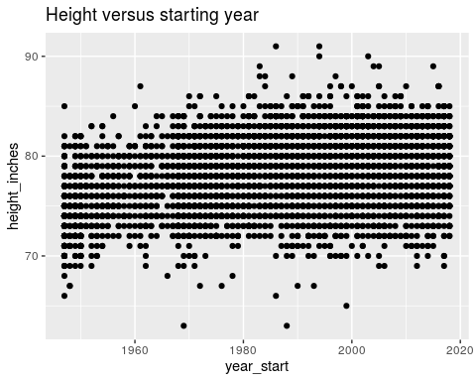

Slide 14
## Question 8 3D plot of height versus weight, colored by position

Slide 15
Slide with Bullets
Bullet 1
Bullet 2
Bullet 3

Slide 16
Slide with R Output
summary(cars)
## speed dist ## Min. : 4.0 Min. : 2.00 ## 1st Qu.:12.0 1st Qu.: 26.00 ## Median :15.0 Median : 36.00 ## Mean :15.4 Mean : 42.98 ## 3rd Qu.:19.0 3rd Qu.: 56.00 ## Max. :25.0 Max. :120.00

Slide 17
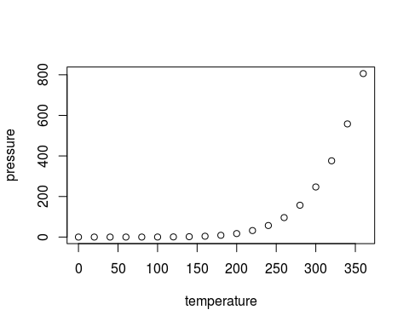
Slide with Plot

